Slide 1

Cluster-in-a-box
Deploying Kubernetes with LXD & Machine Containers

Slide 2




Rye Terrell @wwwtyro
Marco Ceppi @marcoceppi

Slide 3


Slide 4


Slide 5

What is the Silph Road?
Volunteer run / operated community website
30 million+ visitors monthly
1 - 55 developers at any one time
Mix of platforms, languages, and services
Small independant development teams

Slide 6
containers of all kinds

Slide 7
Virtual Machines
Machine Containers
Process Containers
Traditional operations
Traditional operations
Mesos / Kubernetes / Swarm
KVM
LXD
Docker / RunC / Rkt
Host Linux Filesystem

Slide 8



LXC the og linux container
Notes:
lxc list
lxc launch ubuntu:xenial
lxc list
lxc launch images:centos/7 lxc list
lxc exec <ubuntu-image> lsb_release -a lxc exec <centos-image> cat /etc/redhat-release
lxc exec <centos-image> yum update
lxc image list images: | less
lxc exec <centos-image> pstree

Slide 9
LXD is a container hypervisor, LXC is the container
host A
host B
host C
host D
host ...
Ultra fast “vm-lite” guests (bare metal speed)
Any distribution of Linux - e.g. Ubuntu, CentOS
Starts in less than 1 second
15x density of KVM or ESX for idle workloads
lxc machine
lxc machine
lxc machine
lxc machine
lxc machine
kernel
lxd
kernel
lxd
kernel
lxd
kernel
lxd
kernel
lxd
LXD REST API
nova-lxd
lxc cli
other restful apps

Slide 10
consistent developer experience

Slide 11
cluster in a box!

Slide 12


Slide 13



Slide 15
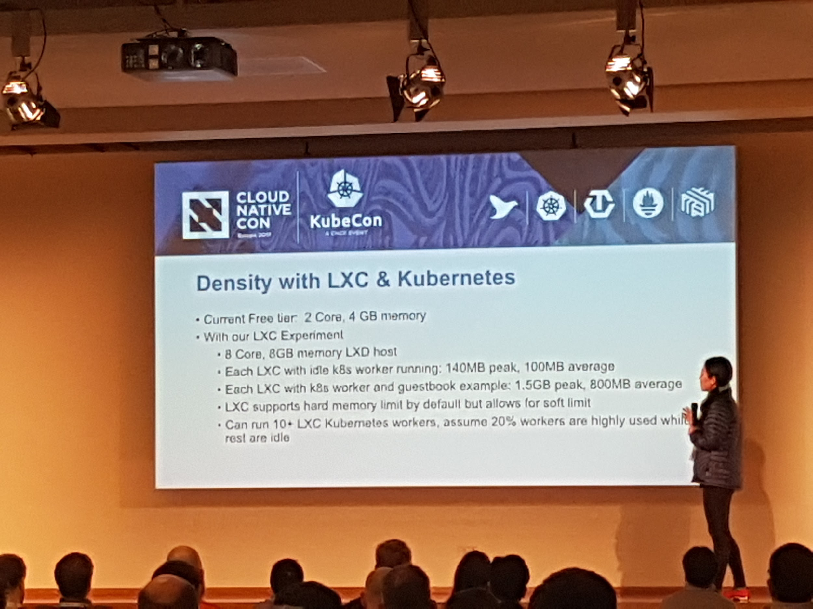
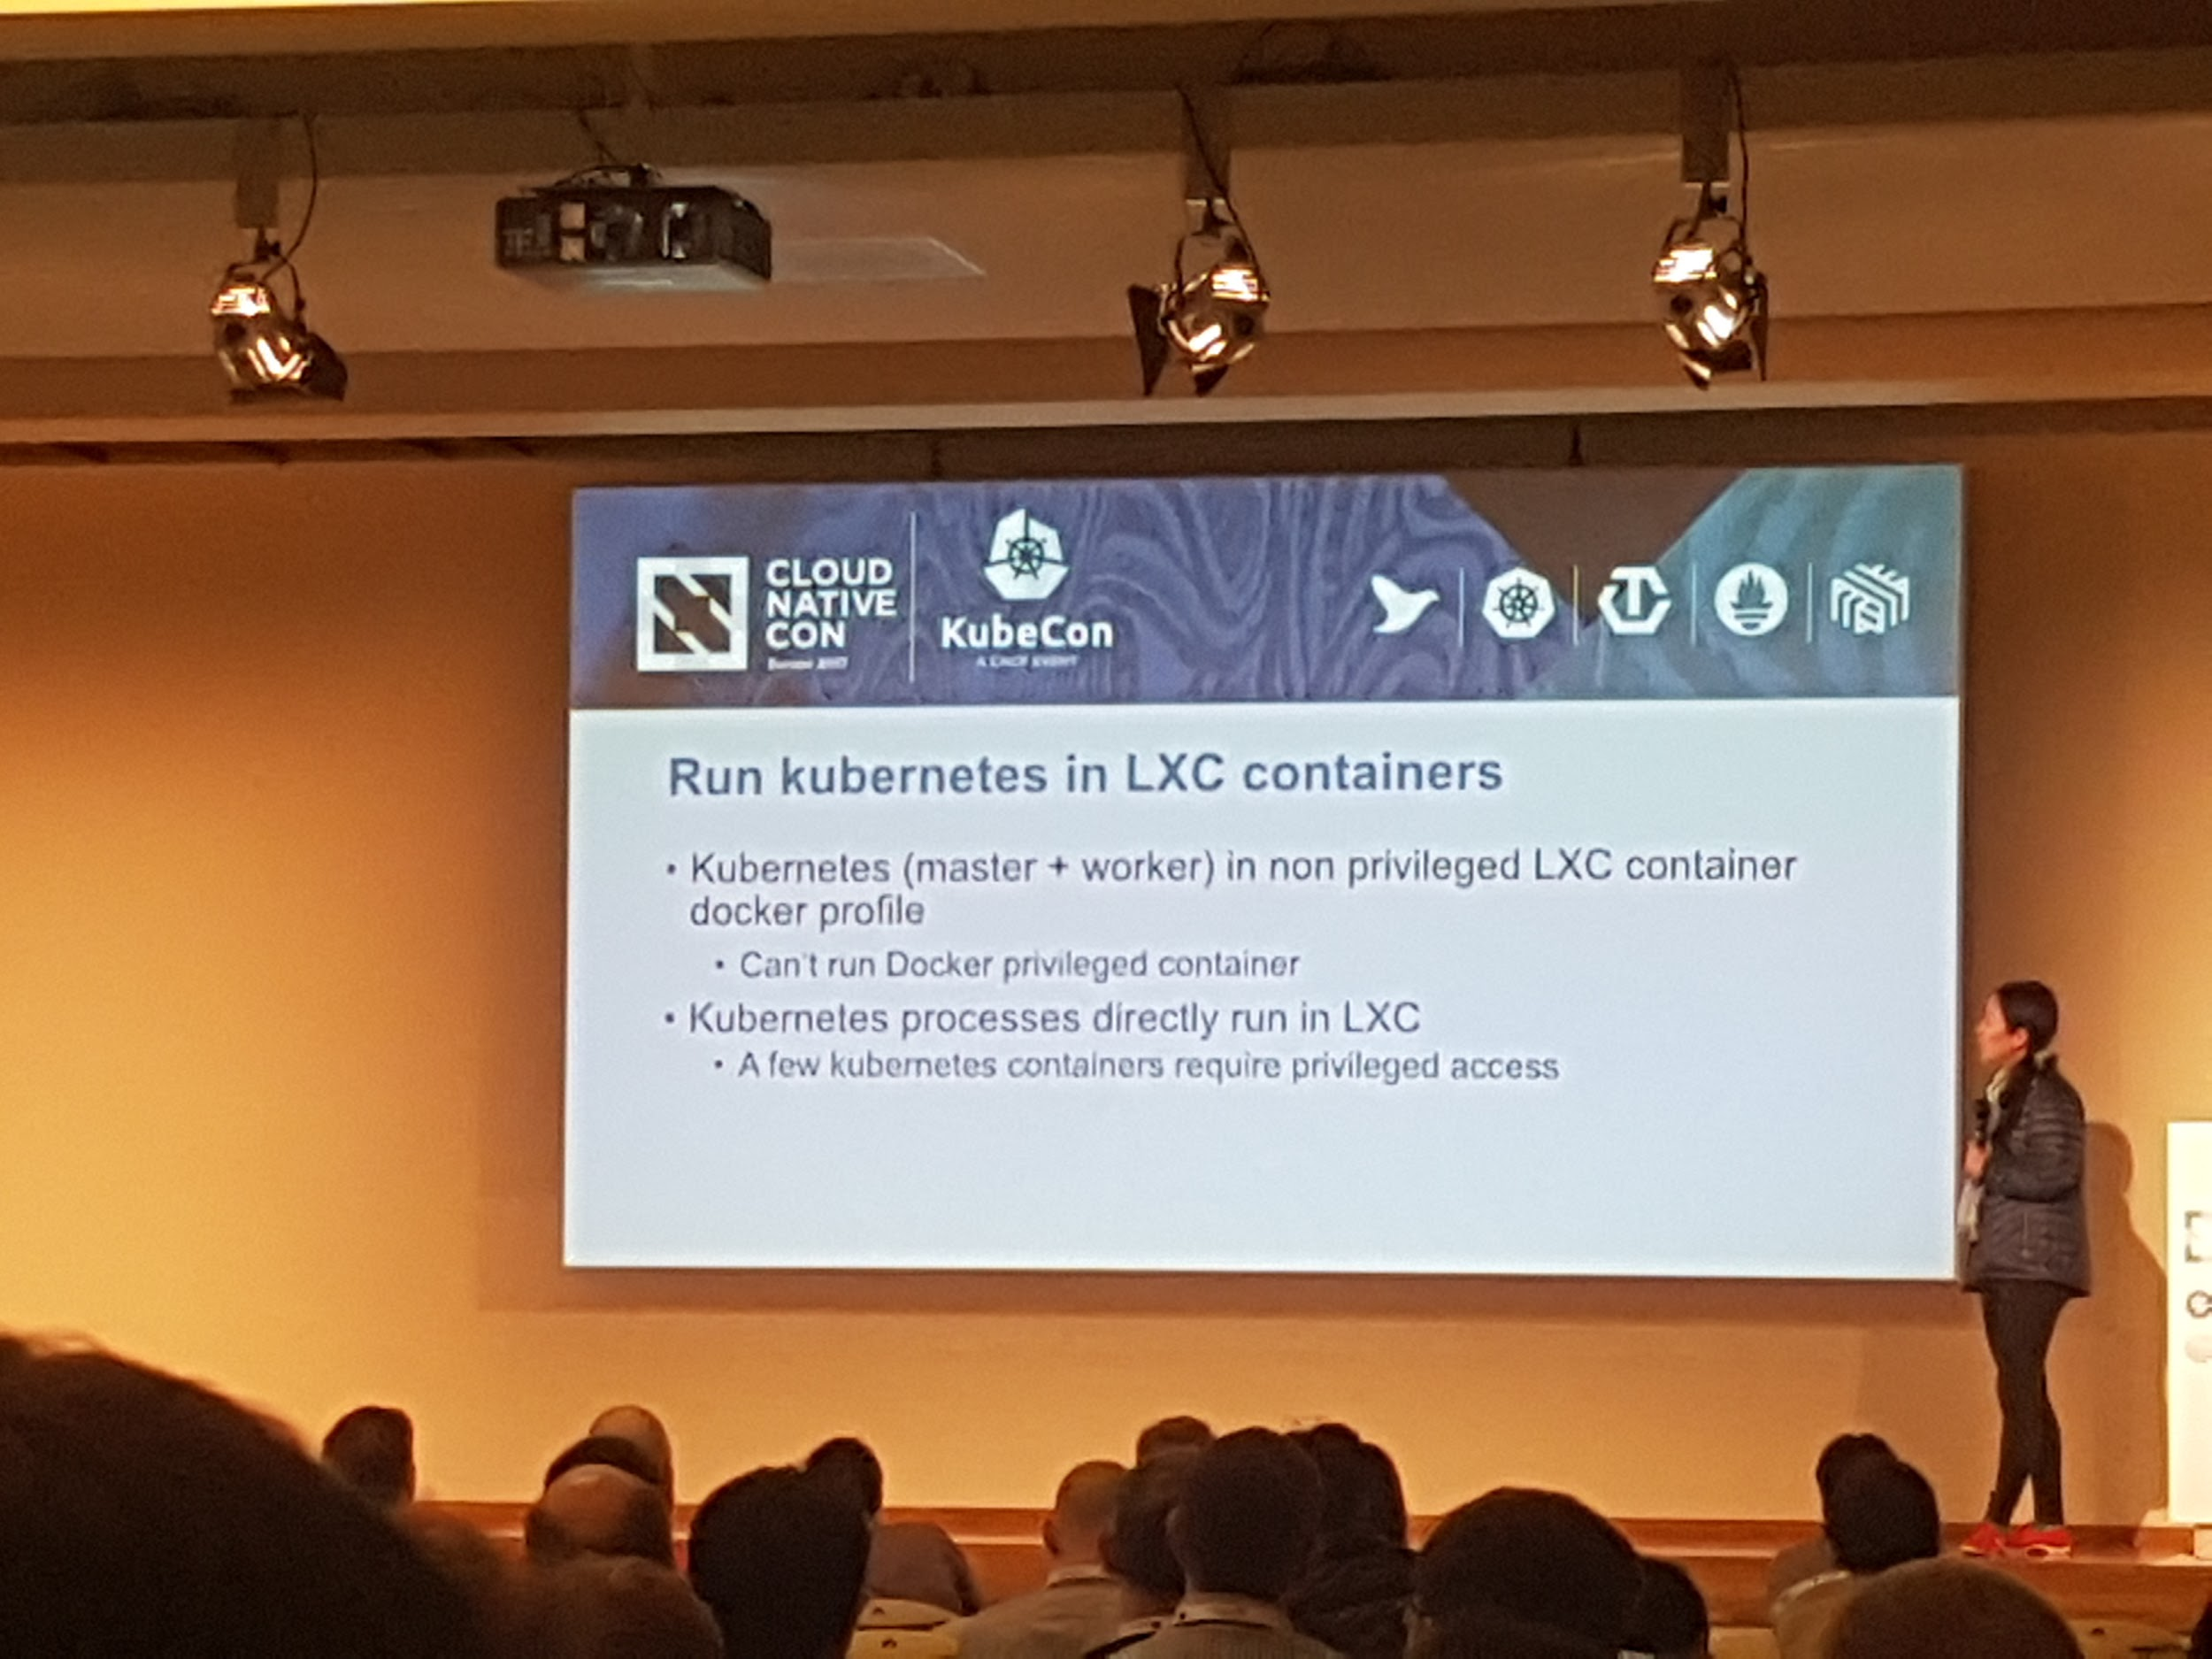
Lin Sun from IBM BlueMix at CloudNativeCon/KubeCon Berlin, March 2017 https://cloudnativeeu2017.sched.com/event/9Tbz/leverage-lxdlxc-with-kubernetes-a-lin-sun-ibm

Slide 18
bare metal & large clusters
the 100 pod dilemma

Slide 19
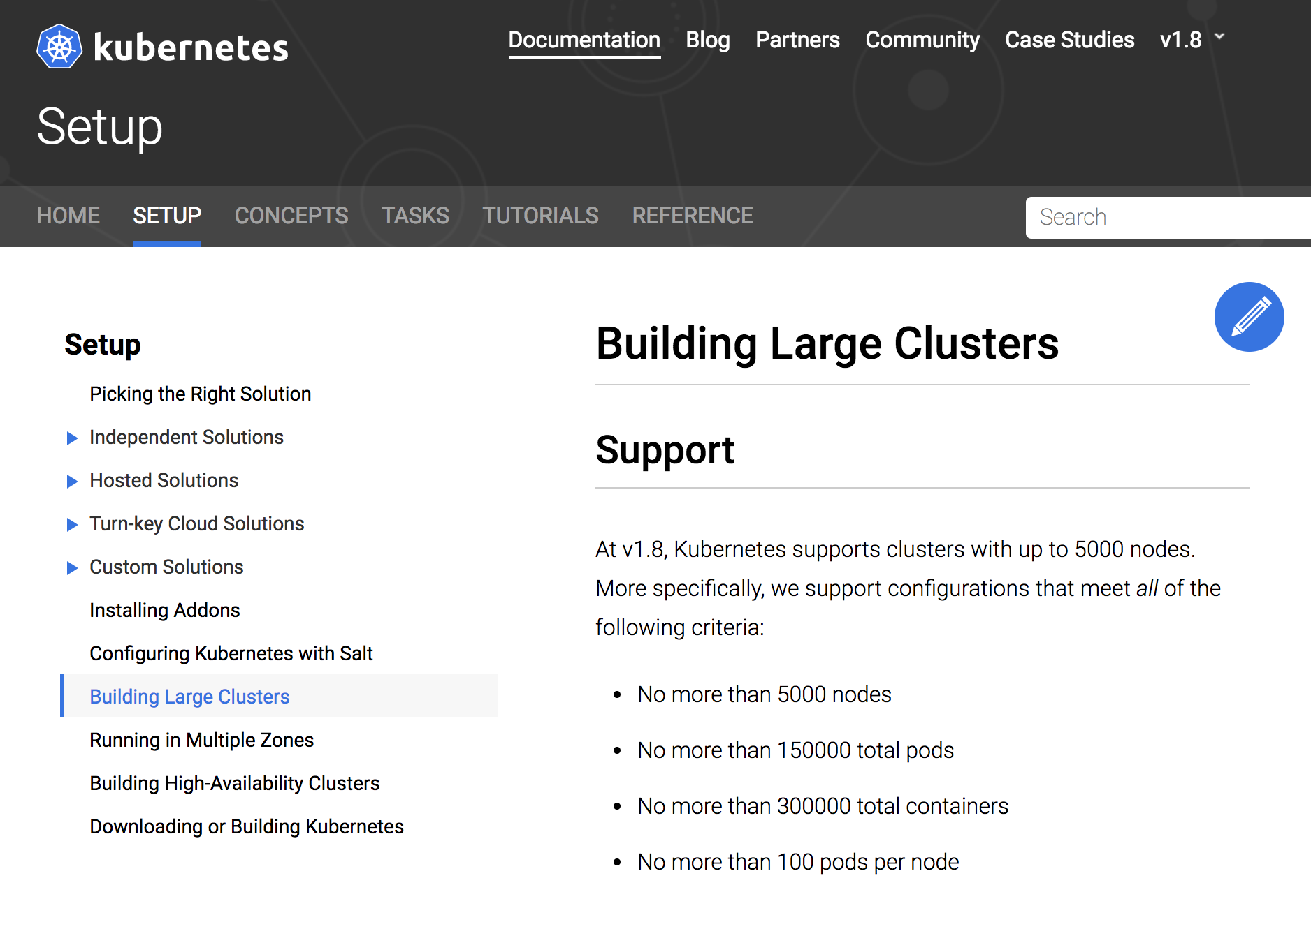

Slide 20




average x86 server
24 cpu cores
500 GB memory
20 TB storage

Slide 21
great if you have sparse, compute intensive pods
not great otherwise

Slide 22
100 pod limit

Slide 23
400 pod limit

Slide 24
900 pod limit

Slide 25
600 pod limit

Slide 26
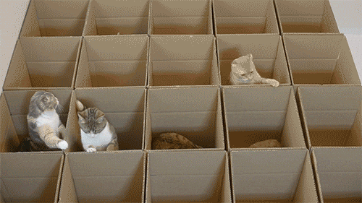
Virtual Machines
Machine Containers

Slide 27
THANK YOU

Slide 28
THANK YOU
linuxcontainers.org cncf.io/certification/expert kubernetes.io/docs/admin/cluster-large

